Slide 1
Cookie Monster
Karen Franklin
4/13/21

Slide 2

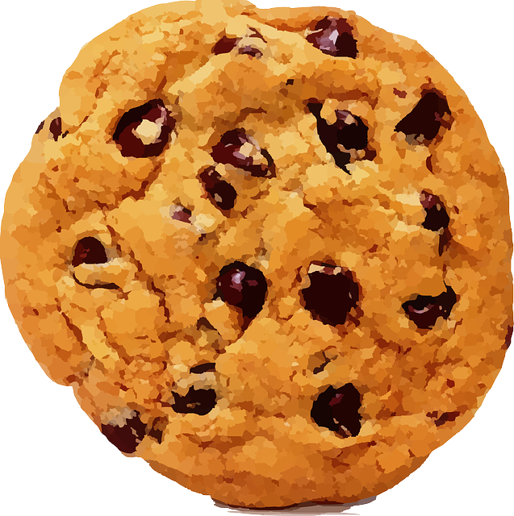

Introduction
A game where you control the monster. Your goal is to catch the cookies but avoid the rocks. Each cookie counts for one point. But if you get hit by a rock, the game is over.
Visual Components:

Slide 3
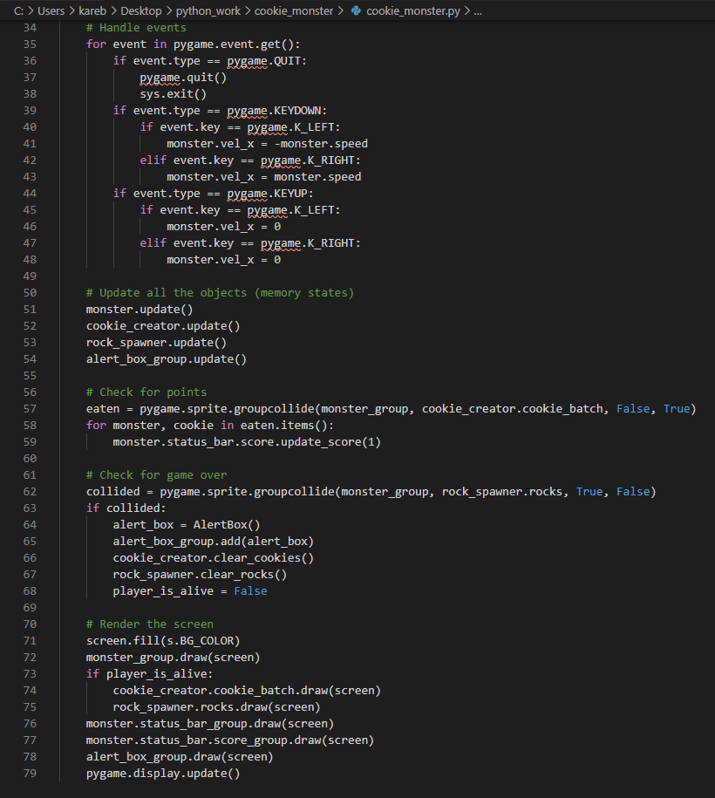
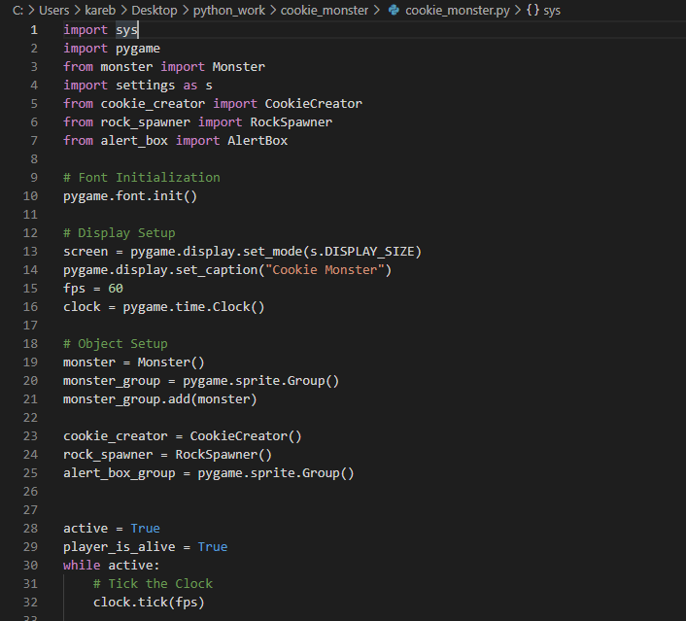
cookie_monster - This is my main file where most of the game code is. I did not make this code into a class. I kept it in a simpler format so it was easier to understand. I made all the objects in the game into classes and imported them into this file.

Slide 4
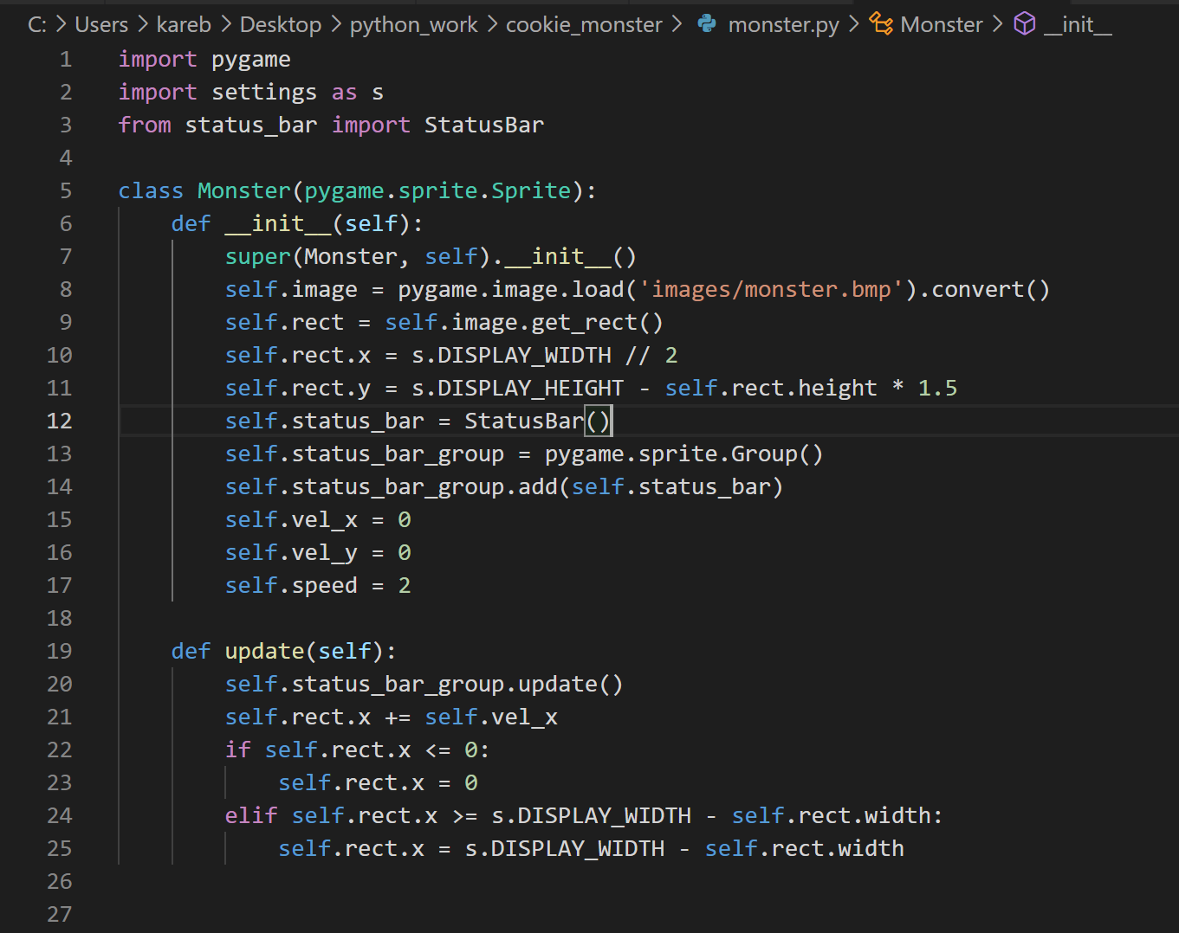
class Monster - This class sets the image data for the monster and the update function permits the monster from traveling off screen.

Slide 5
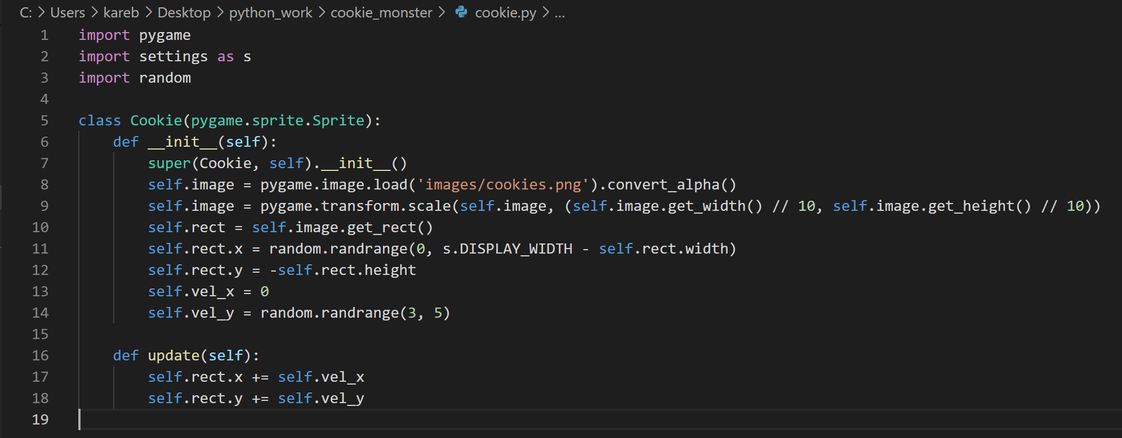
class Cookie - This class defines the image settings for the Cookie and the update function controls how quickly the cookie descends in the screne.

Slide 6
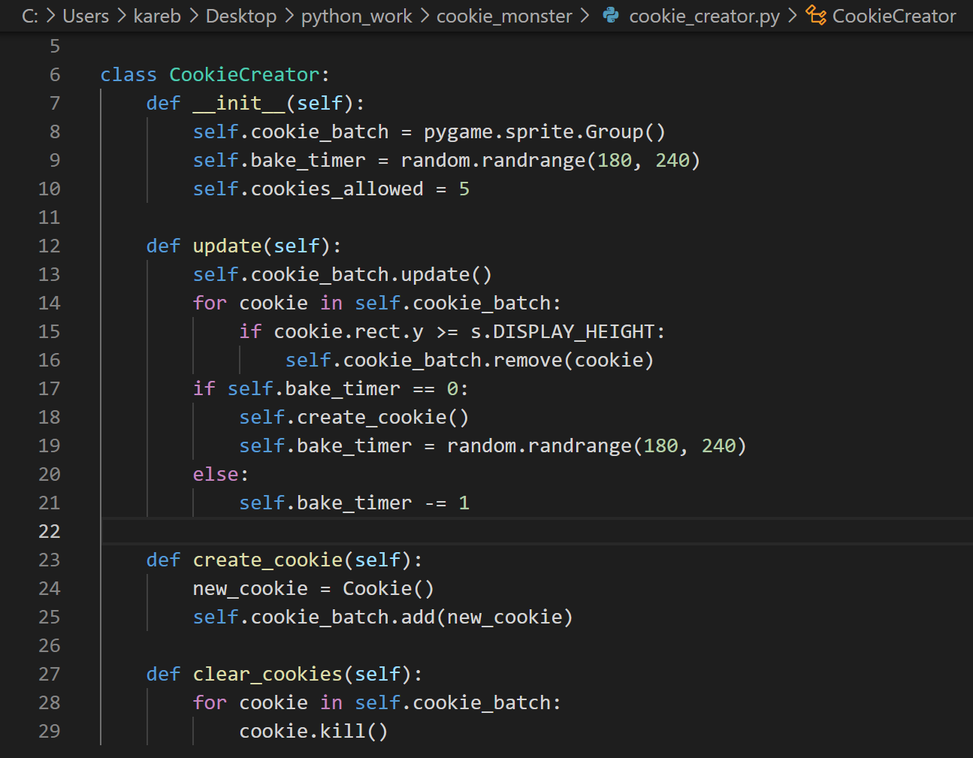
class CookieCreator - This class controls the sprite Group for the cookies. The cookies are created at random intervals and removed once they fall off the screen.

Slide 7
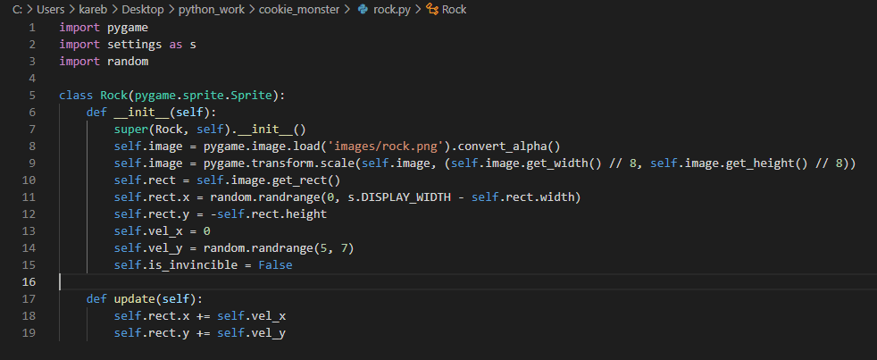
class Rock - This class defines the image settings for the rock and the update function controls how quickly the rock descends in the screne.

Slide 8
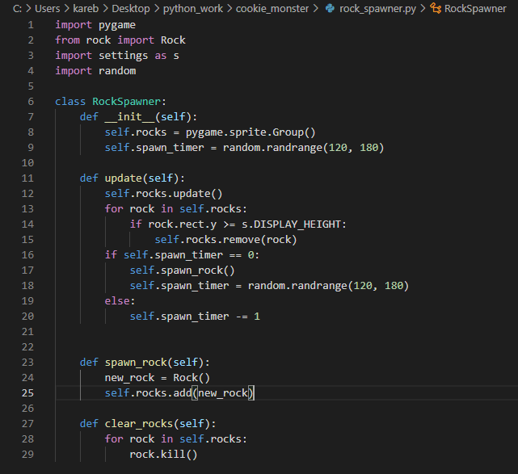
class RockSpawner - This class controls the sprite Group for the rocks. The rocks are created at random intervals and removed once they fall off the screen.

Slide 9
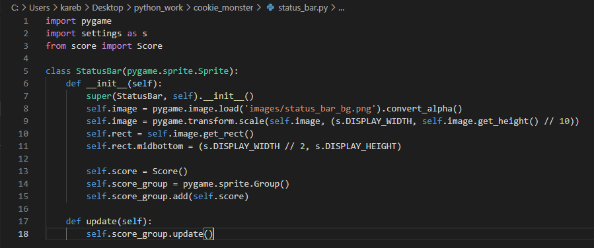
class StatusBar - This StatusBar class handles the image data for the status bar at the bottom of the screen. This class also places the score inside the status bar.

Slide 10
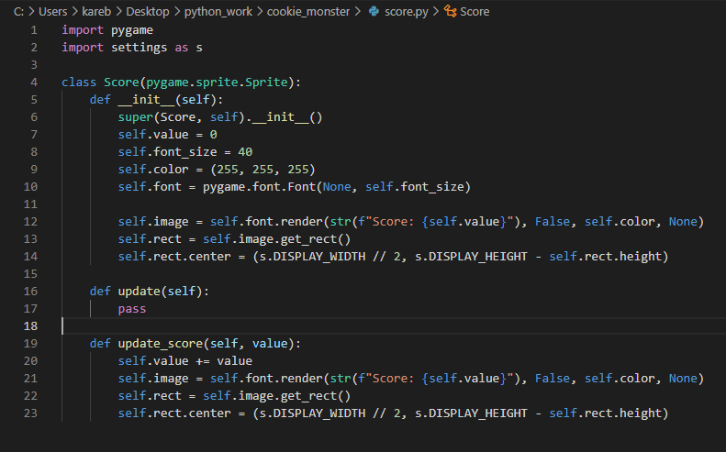
class Score - This Score class handles the image of the score and updates the score and renders the image again when the score is updated.

Slide 11
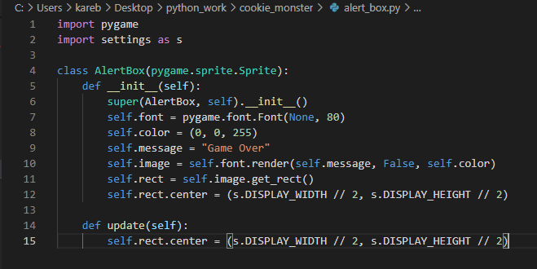
class AlertBox - The AlertBox class builds the image details of the final Game Over message.

Slide 12
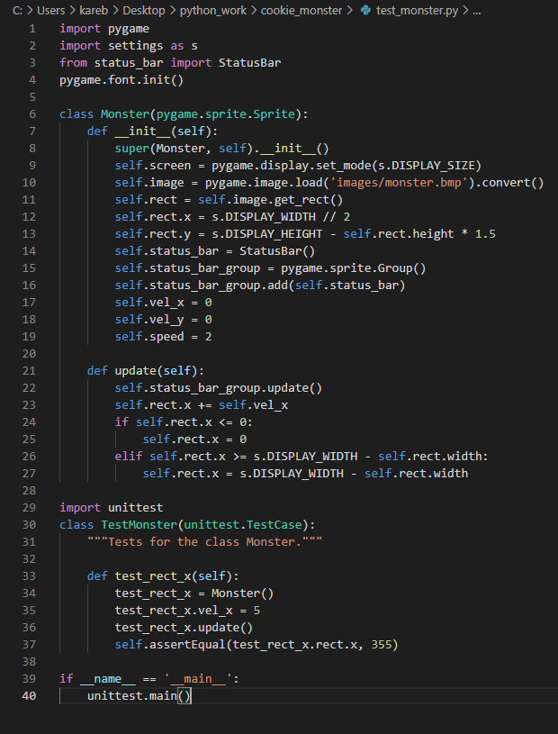
Test_monster - This test case confirms that as the monster’s velocity increases, so does the monster’s x location.

Slide 13
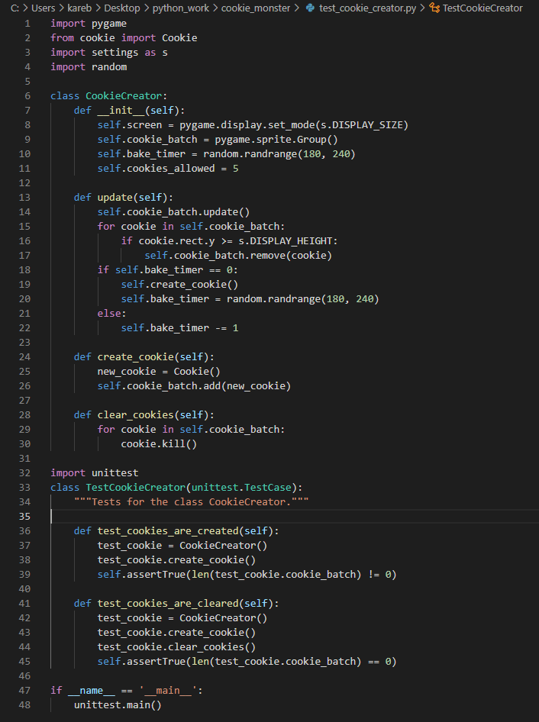
Test_Cookie_Creator - This test case confirms that cookies are added and removed from the sprite Group whenever the create_cookie and clear_cookie functions are called, respectively.

Slide 14
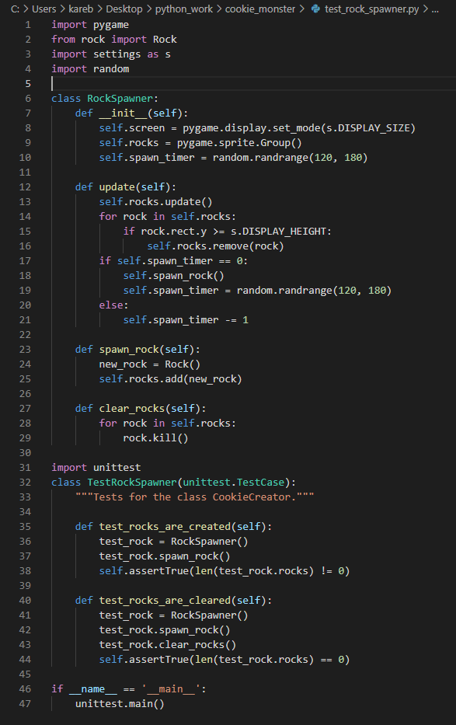
Test_Rock_Spawner - This test case confirms that rocks are added and removed from the sprite Group whenever the spawn_rock and clear_rock functions are called, respectively.

Slide 15
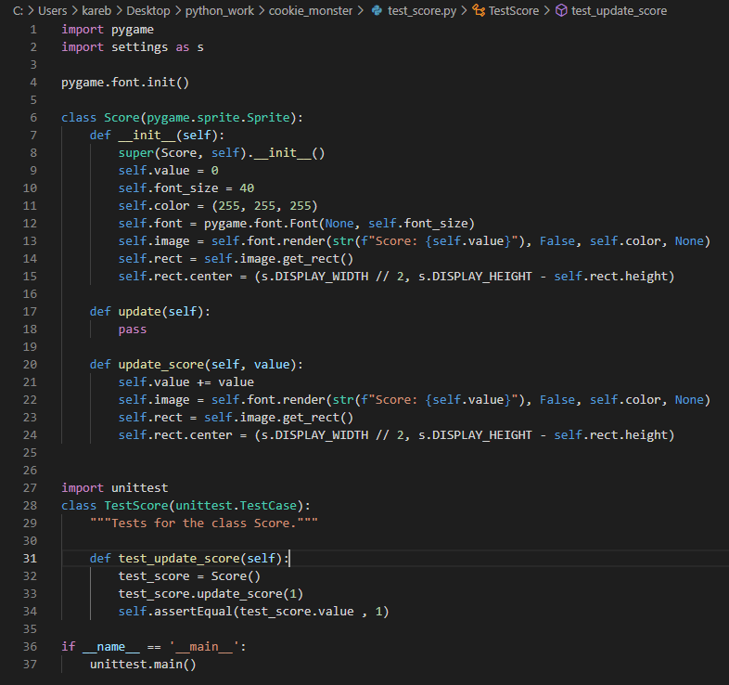
Test_Score - This test case confirms that every time the update_score function is called, the value of the score increases by 1.

Slide 16
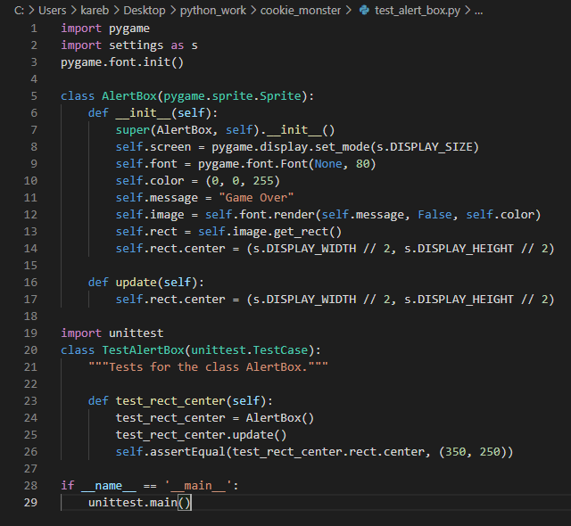
Test_Alert_Box - This test case confirms the location of the final game over message.

Slide 17
Lessons Learned
I’ve never been exposed to Pygame at all. So, the entire experience of working with pygame was a learning lesson. I found the pygame explanations in the book difficult to follow. But I was able to find tutorials online that I found much easier to understand. Finding the resource that made sense to me changed this project from something that I was struggling through, to something that I genuinely enjoyed doing.

Slide 18
Project Location
Github - https://github.com/KJHFrank/github-upload.git

